Slide 1


Nilesh Devdas

Slide 2
Background
A pattern provides a solution to a common problem by:
Reusablity
Communication,
education,
understanding of key development concepts
Industry Standard Approach
10010011000100100100100
10010011000100100100100
10010011000100100100100
10010011000100100100100
10010011000100100100100
10010011000100100100100
10010011000100100100100
10010011000100100100100
10010011000100100100100
10010011000100100100100
10010011000100100100100
Problem
Exemplar
(Solution)
Pattern
Specification
Pattern
Implementation

Slide 3
Why patterns?
Promotes Reuse of solutions that have worked in the past
Well-structured object-oriented systems have recurring patterns of classes and objects
Knowledge of the patterns allows a designer to be more productive
Designs can be more flexible and reusable and robust

Slide 4
Pattern Specifications
At first, patterns exist only as an idea in the mind of the developer, as a best practice used in many projects.
Patterns are often captured as pattern specifications.
A pattern specification formally documents:
The problem the pattern solves
The solution it provides
A strategy for applying the pattern in its context
Consequences, advantages, and disadvantages of applying the pattern

Slide 5
Benefits of Pattern Implementations
Increased productivity
Simplifies and accelerates the building and testing of software
Dramatically reduces development cycle times by eliminating repetitive work
Offers ease of use for beginners
Improved software governance
Consistently enforce architectural, design, and coding standards
Increased quality
Higher quality end product due to a higher level of consistency
Greater leverage of expert skills within the development organization
Increased openness
Less dependency on a specific tool, vendor, or platform

Slide 6
Java Design Pattern
Categories

Slide 7
GoF Design Pattern Category
Design Patterns
Creational
Structural
Behavioural

Slide 8
Creational Patterns
Abstract Factory
Factory Method
Creational Patterns
Prototype
Singleton
Builder

Slide 9
Structural Patterns
Adapter
Composite
Decorator
Structural Patterns
Proxy
Façade
Flyweight
Bridge

Slide 10
Behavioral Pattern
Chain Of Responsibility
Command
Iterator
Observer
Behavioral
State
Strategy
Template Method
Mediator
Visitor
Interpreter

Slide 11

Implementing Patterns
Using Java

Slide 12
Creational Patterns

Slide 13
Creational Patterns
Creational design patterns abstract the instantiation process
They help make a system independent of how its objects are created, composed, and represented
A class creational pattern uses inheritance to vary the class that's instantiated

Slide 14
Creational Patterns
Abstract Factory
Factory Method
Creational Patterns
Prototype
Singleton
Builder

Slide 15
Structural Pattern

Slide 16
Where are we
Abstract Factory
Factory Method
Builder
Singleton
Prototype

Slide 17
Abstract Factory
Creational Pattern

Slide 18
Intent
Provide an interface for creating families of related or dependent objects without specifying their concrete classes

Slide 19
Also Known As (A.K.A)
Kit

Slide 20
Motivation
A User interface toolkit that supports multiple look-and-feel standards.
To be portable across look-and-feel standards it should not hard-code look and feel on widgets
To solve this problem we can declare a interface from creating each basic kind of widget.
There is also a Abstract class for each kind of widget and a concrete subclass implementation
Clients create widgets solely through the WidgetFactory interface and have no knowledge of the classes that implement widgets for a particular look and feel.
In other words, clients only have to commit to an interface defined by an abstract class, not a particular concrete class

Slide 21
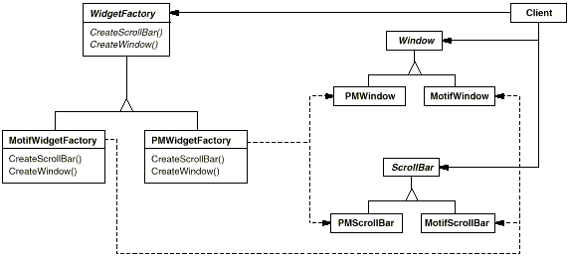
Motivation

Slide 22
Applicability
Use the Abstract Factory pattern when
a system should be independent of how its products are created, composed, and represented.
a system should be configured with one of multiple families of products.
a family of related product objects is designed to be used together, and you need to enforce this constraint.
you want to provide a class library of products, and you want to reveal just their interfaces, not their implementations.

Slide 23
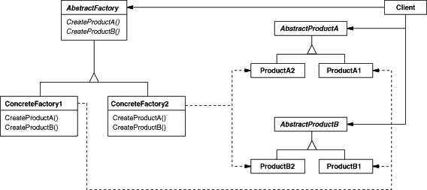
Structure

Slide 24
Participants
AbstractFactory (WidgetFactory)
declares an interface for operations that create abstract product objects.
ConcreteFactory (MotifWidgetFactory, PMWidgetFactory)
implements the operations to create concrete product objects.
AbstractProduct (Window, ScrollBar)
declares an interface for a type of product object.
ConcreteProduct (MotifWindow, MotifScrollBar)
defines a product object to be created by the corresponding concrete factory.
implements the AbstractProduct interface.
Client
uses only interfaces declared by AbstractFactory and AbstractProduct classes

Slide 25
Collaborations
Normally a single instance of a Concrete Factory class is created at run-time.
This concrete factory creates product objects having a particular implementation.
To create different product objects, clients should use a different concrete factory
AbstractFactory defers creation of product objects to its Concrete Factory subclass

Slide 26
Consequences
Pro’s
It isolates concrete classes
It makes exchanging product families easy
It promotes consistency among products.
Con’s
Supporting new kinds of products is difficult.
Extending abstract factories to produce new kinds of Products isn't easy.
That's because the AbstractFactory interface fixes the set of products that can be created.

Slide 27
Implementation
Factories generally are Singleton
Abstract Factory only declares a interface for creating products
ConcreteFactory has the control to create the ConcreteProduct
Defining extensible factories.
Operations Defines the kind of product required
a new kind of product requires changing the AbstractFactory interface and all the classes that depend on it
More flexible but less safe design is to add a parameter to operations that create objects

Slide 28
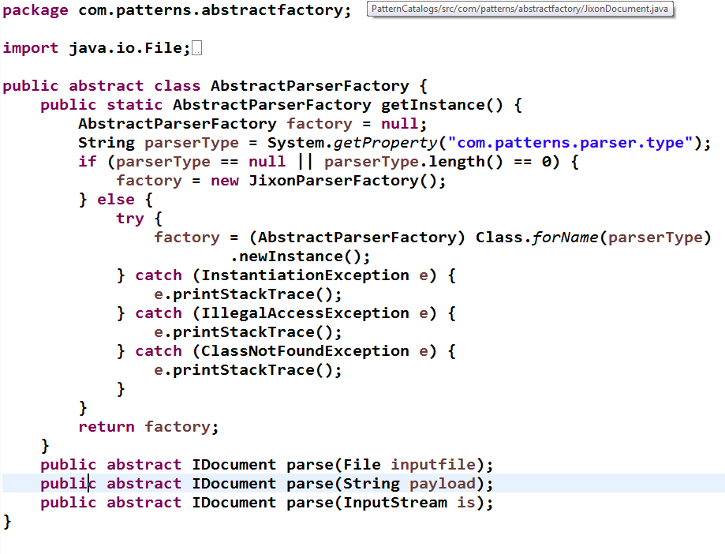
Sample Code
Create Default
Factory
Create Dynamic
Factory on Configuration

Slide 29
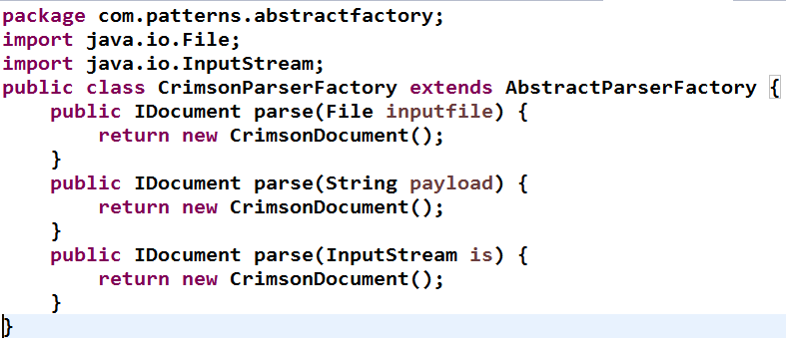
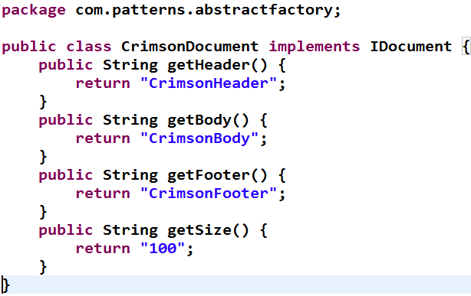
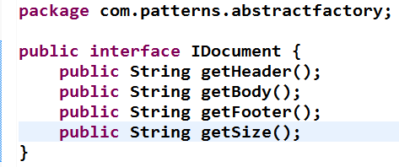

Slide 30
Java Known Uses
JAX-RPC
ServiceFactory
JAXP
DocumentBuilderFactory
SAXParserFactory

Slide 31
Related Patterns
AbstractFactory classes
Often implemented with factory methods
ConcreteFactory
Often to be implemented as a Singleton

Slide 32
Where are we
AbstractFactory
FactoryMethod
Builder
Singleton
Prototype

Slide 33
Factory Method
A Creational Pattern

Slide 34
Intent
Define an interface for creating an object, but let subclasses decide which class to instantiate.
Factory Method lets a class defer instantiation to subclasses.

Slide 35
Also Known As (A.K.A)
Virtual Constructor

Slide 36
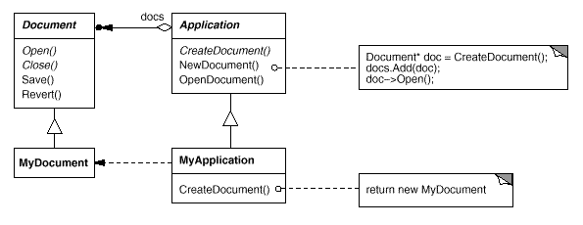
Motivation
The essence of the Factory Pattern is to "Define an interface for creating an object, but let the subclasses decide which class to instantiate. The Factory method lets a class defer instantiation to subclasses."

Slide 37
Applicability
Use the Factory Method pattern when
a class can't anticipate the class of objects it must create.
a class wants its subclasses to specify the objects it creates.
classes delegate responsibility to one of several helper subclasses, and you want to localize the knowledge of which helper subclass is the delegate.

Slide 38
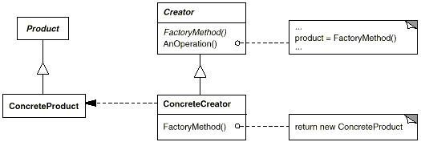
Structure

Slide 39
Participants
Product (Document)
defines the interface of objects the factory method creates.
ConcreteProduct (MyDocument)
implements the Product interface.
Creator (Application)
declares the factory method, which returns an object of type Product. Creator may also define a default implementation of the factory method that returns a default ConcreteProduct object.
may call the factory method to create a Product object.
ConcreteCreator (MyApplication)
overrides the factory method to return an instance of a ConcreteProduct.

Slide 40
Collaborations
Creator relies on its subclasses to define the factory method so that it returns an instance of the appropriate ConcreteProduct.

Slide 41
Consequences
Provides hooks for subclasses
Creating objects inside a class with a factory method is always more flexible than creating an object directly

Slide 42
Implementation
Two major varieties.
The two main variations of the Factory Method pattern are
1) The Creator class is an abstract class and does not provide an implementation for the factory method it declares,
2) The Creator is a concrete class and provides a default implementation for the factory method.
It's also possible to have an abstract class that defines a default implementation, but this is less common.
Parameterized factory methods.
lets the factory method create multiple kinds of products

Slide 43
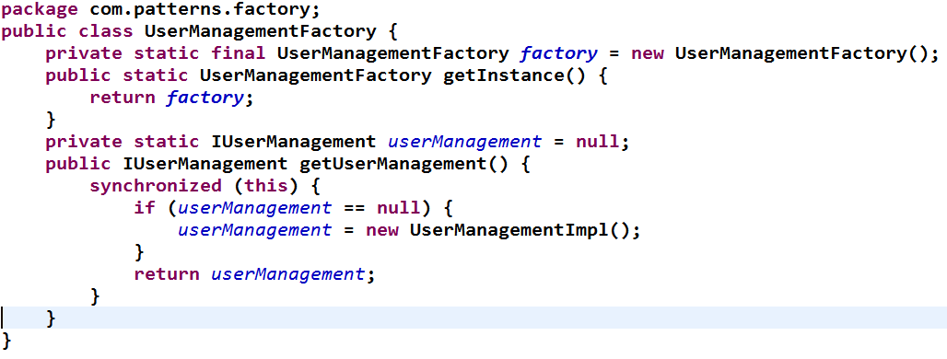
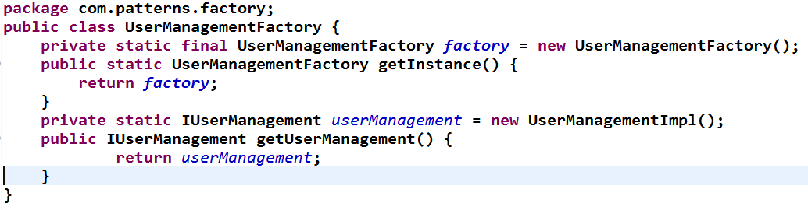
Sample Code
Synchronized Block for guaranteed single
Eager Instantiation

Slide 44
Known Uses
org.omg.CORBA.Object objRef = orb.resolve_initial_references("NameService");

Slide 45
Related Patterns
AbstractFactory
often implemented with factory methods
Prototypes

Slide 46
Where are we
Abstract Factory
Factory Method
Singleton
Prototype
Builder

Slide 47
Singleton
Creational Pattern

Slide 48
Intent
Ensure a class only has one instance, and provide a global point of access to it.

Slide 49
Also Known As (A.K.A)
Registry
Locator

Slide 50
Motivation
It's important for some classes to have exactly one instance.
How do we ensure that a class has only one instance and that the instance is easily accessible?
A global variable makes an object accessible, but it doesn't keep you from instantiating multiple objects.
A better solution is to make the class itself responsible for keeping track of its sole instance

Slide 51
Applicability
Use the Singleton pattern when
There must be exactly one instance of a class, and it must be accessible to clients from a well-known access point.
When the sole instance should be extensible by subclassing, and clients should be able to use an extended instance without modifying their code.

Slide 52
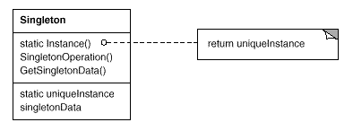
Structure

Slide 53
Participants
Singleton
Defines an Instance operation that lets clients access its unique instance.
Instance is a class operation (that is, a class method in java (static)).
may be responsible for creating its own unique instance.

Slide 54
Collaborations
Clients access a Singleton instance solely through Singleton's Instance operation.

Slide 55
Consequences
Controlled access to sole instance
Reduced name space
Permits refinement of operations and representation
Permits a variable number of instances
More flexible than class operations

Slide 56
Implementation
Ensuring a unique instance
Earger v/s Lazy Initialization

Slide 57
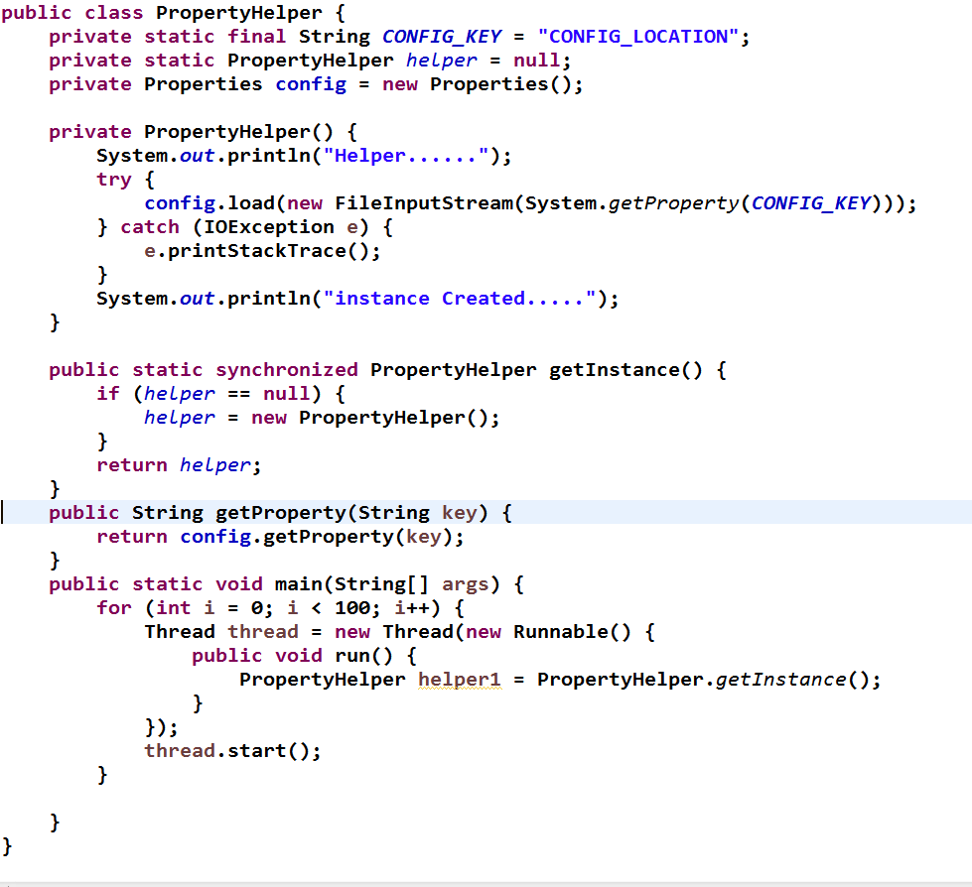
Sample Code lazy Init
Synchronized to Avoid multi instance creation

Slide 58
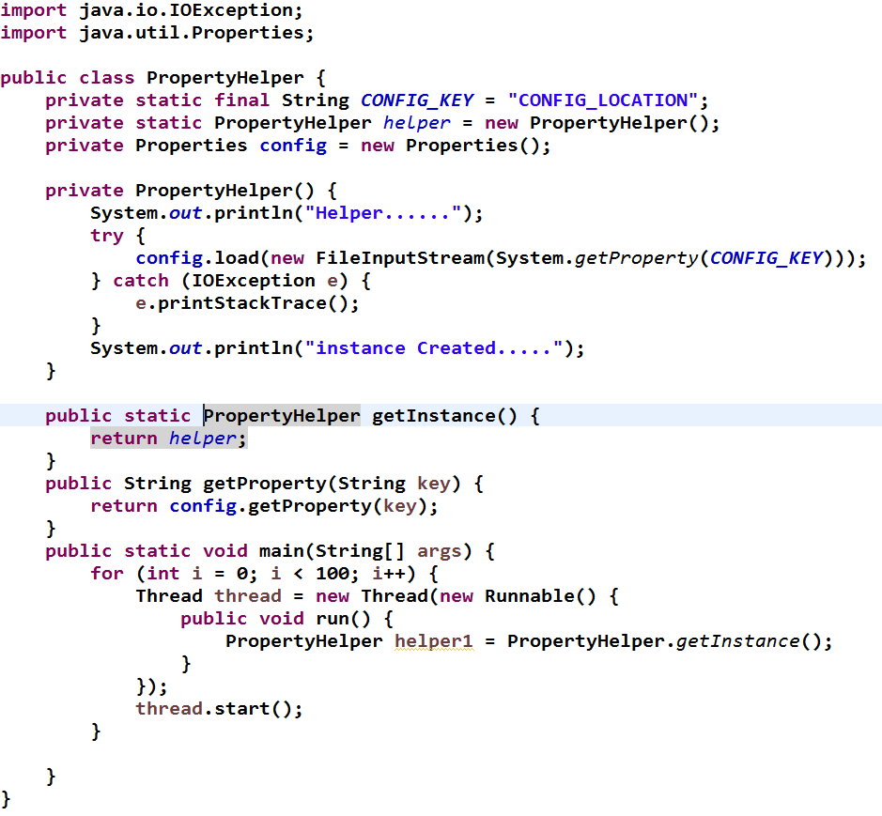
Sample Code for Eager Init

Slide 59
Known Uses
ConnectionPool
Registry
ServiceLocator
Cacher

Slide 60
Related Patterns
Many Patterns can be implemented using Singleton

Slide 61
Where are we
Abstract Factory
Factory Method
Singleton
Prototype
Builder

Slide 62
Prototype
Creational Pattern

Slide 63
Intent
Specify the kinds of objects to create using a prototypical instance, and create new objects by copying this prototype.

Slide 64
Also Known As (A.K.A)
Clone
CopyObject

Slide 65
Motivation
If you wish to sort a data without affecting the original
If you wish to edit the music track while keeping the original track intact

Slide 66
Applicability
Use the Prototype pattern when
a system should be independent of how its products are created, composed, and represented; and when the classes to instantiate are specified at run-time, for example, by dynamic loading; or
to avoid building a class hierarchy of factories that parallels the class hierarchy of products;
when instances of a class can have one of only a few different combinations of state.
It may be more convenient to install a corresponding number of prototypes and clone them rather than instantiating the class manually, each time with the appropriate state.

Slide 67
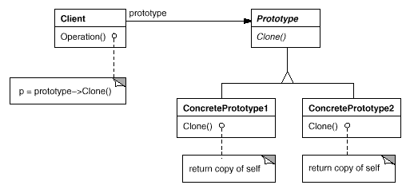
Structure

Slide 68
Participants
Prototype (Graphic)
Declares an interface for cloning itself.
ConcretePrototype (Staff, WholeNote, HalfNote)
Implements an operation for cloning itself.
Client (GraphicTool)
Creates a new object by asking a prototype to clone itself.

Slide 69
Collaborations
A client asks a prototype to clone itself

Slide 70
Consequences
Adding and removing products at run-time
Specifying new objects by varying values
Reduced subclassing

Slide 71
Implementation
Using a prototype manager
Implementing the Clone operation
Initializing clones
Deep Clones v/s Shallow Clones

Slide 72
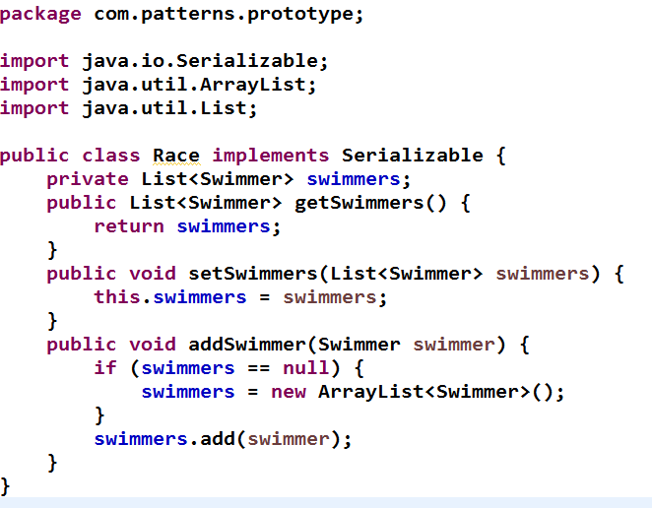
Example Code

Slide 73
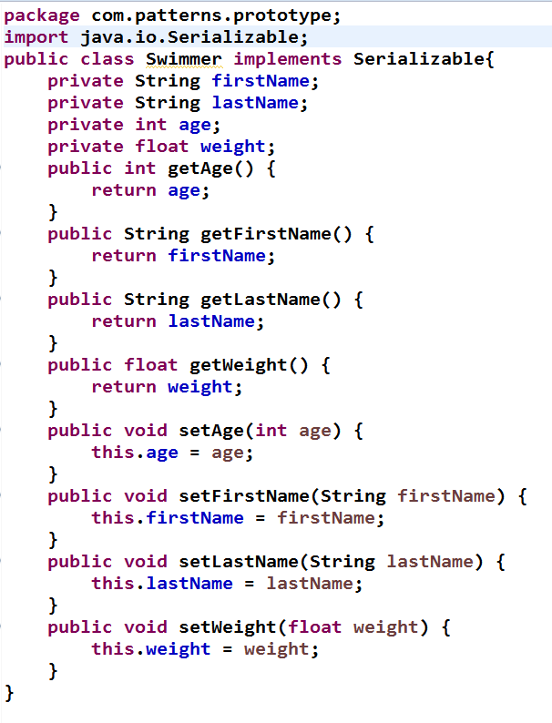
Example Code

Slide 74
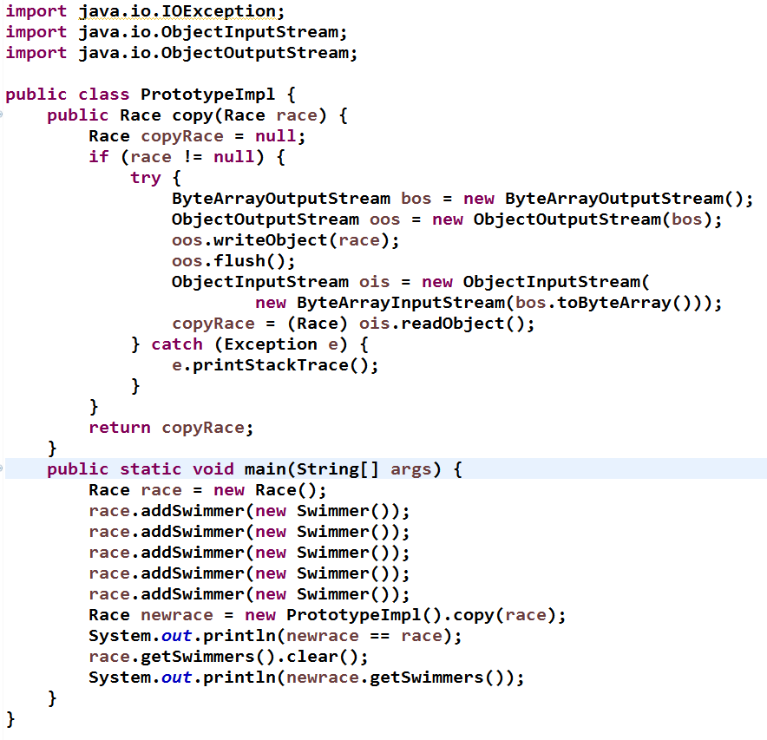
Example Code
Deep copy
Using Serialization

Slide 75
Known Uses
Data Structure Manipulation
Data Sorting
Ordering

Slide 76
Related Patterns
Prototype and AbstractFactory may compete each other in some cases.

Slide 77
Where are we
Abstract Factory
Factory Method
Singleton
Prototype
Builder

Slide 78
Builder
Creational Pattern

Slide 79
Intent
Separate the construction of a complex object from its representation so that the same construction process can create different representations.

Slide 80
Motivation
Focus on constructing a complex object step by step.
Abstract Factory emphasizes a family of product objects (either simple or complex).
Builder returns the product as a final step
Abstract Factory is concerned, the product gets returned immediately.

Slide 81
Applicability
Use the Builder pattern when
the algorithm for creating a complex object should be independent of the parts that make up the object and how they're assembled.
the construction process must allow different representations for the object that's constructed.

Slide 82
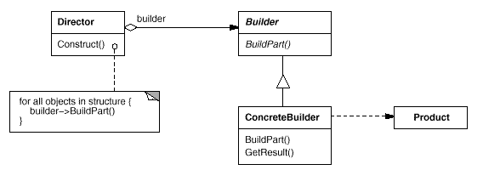
Structure

Slide 83
Participants
Builder (PromoKitBuilder)
specifies an abstract interface for creating parts of a Product object.
ConcreteBuilder (MensKitBuilder, WomensKitBuilder)
constructs and assembles parts of the product by implementing the Builder interface.
defines and keeps track of the representation it creates.
provides an interface for retrieving the product (PromoKit).
Director (PromoKitDirector)
constructs an object using the Builder interface.
Product (PromoKit)
represents the complex object under construction.
ConcreteBuilder builds the product's internal representation and defines the process by which it's assembled.
includes classes that define the constituent parts, including interfaces for assembling the parts into the final result.

Slide 84
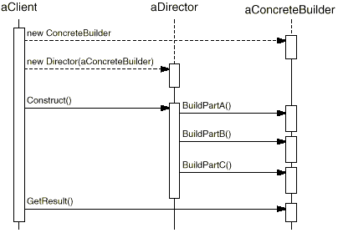
Collaborations
The client creates the Director object and configures it with the desired Builder object.
Director notifies the builder whenever a part of the product should be built.
Builder handles requests from the director and adds parts to the product.
The client retrieves the product from the builder.

Slide 85
Consequences
It lets you vary a product's internal representation
It isolates code for construction and representation
It gives you finer control over the construction process

Slide 86
Implementation
Typically there's an abstract Builder class that defines an operation for each component that a director may ask it to create.
The operations do nothing by default.
A ConcreteBuilder class overrides operations for components it's interested in creating.

Slide 87
Sample Code

Slide 88
Known Uses
The algorithm for creating a complex object should be independent of both the parts that make up the object and how the parts are assembled.
The construction process must allow different representations of the constructed object.

Slide 89
Related Patterns
Abstract Factory is similar to Builder in that it too may construct complex objects
A Composite is what the builder often builds.

Slide 90
Summary Of Creational Patterns
Abstract Factory 1
Groups object factories that have a common theme.
Builder 2
Constructs complex objects by separating construction and representation.
Factory Method 3
Creates objects without specifying the exact class to create.
Prototype 4
Creates objects by cloning an existing object.
Singleton 5
Restricts object creation for a class to only one instance.

Slide 91
Structural Patterns

Slide 92
Structural Patterns
Adapters
Bridge
Composite
Structural Patterns
Decorator
Facade
FlyWeight
Proxy

Slide 93
Where are we
Adapter
Composite
FlyWeight
Proxy
Decorator
Bridge
Facade

Slide 94
Adapter
Structural Pattern

Slide 95
Intent
Convert the interface of a class into another interface clients expect. Adapter lets classes work together that couldn't otherwise because of incompatible interfaces

Slide 96
Also Known As (A.K.A)
Wrapper

Slide 97
Motivation
Sometimes a class that's designed for reuse isn't reusable only because its interface doesn't match the domain-specific interface an application requires.
A client needs the service of an object, Obj, through an interface, IF, but Obj does not implement IF.

Slide 98
Applicability
Use the Adapter pattern when
you want to use an existing class, and its interface does not match the one you need.
you want to create a reusable class that cooperates with unrelated or unforeseen classes, that is, classes that don't necessarily have compatible interfaces.
(object adapter only) you need to use several existing subclasses, but it's impractical to adapt their interface by subclassing every one.
An object adapter can adapt the interface of its parent class.

Slide 99
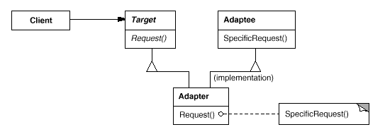
Structure

Slide 100
Participants
Target (TransactionManager)
defines the domain-specific interface that Client uses.
Client (DAOApplication)
collaborates with objects conforming to the Target interface.
Adaptee (Transaction)
defines an existing interface that needs adapting.
Adapter (TransactionAdapter)
adapts the interface of Adaptee to the Target interface

Slide 101
Collaborations
Clients call operations on an Adapter instance.
In turn, the adapter calls Adaptee operations that carry out the request

Slide 102
Consequences
Class and object adapters have different trade-offs.
A class adapter
adapts Adaptee to Target by committing to a concrete Adapter class.
As a consequence, a class adapter won't work when we want to adapt a class and all its subclasses.
lets Adapter override some of Adaptee's behavior, since Adapter is a subclass of Adaptee.
introduces only one object, and no additional refrences is needed to get to the adaptee
An object adapter
lets a single Adapter work with many Adaptees
that is, the Adaptee itself and all of its subclasses (if any).
The Adapter can also add functionality to all Adaptees at once.
makes it harder to override Adaptee behavior.
It will require subclassing Adaptee and making Adapter refer to the subclass rather than the Adaptee itself.

Slide 103
Implementation
BySublclassing (Class Adapter)
ByComposition (Object Adapter)

Slide 104
Sample Code
ConnectionWrapper

Slide 105
Known Uses
J2EE TransactionManagement
J2EE ConnectionPooling

Slide 106
Related Patterns
Bridge
Has A similar Structure to Object Adapter
But the intent is different
Decorator
Enhances Object Without Changing its interface
Proxy
Defines a representative or surrogate for another object and does not change its interface.

Slide 107
Where are we
Adapter
Composite
FlyWeight
Proxy
Decorator
Bridge
Facade

Slide 108
Composite
Structural Pattern

Slide 109
Intent
Compose objects into tree structures to represent part-whole hierarchies. Composite lets clients treat individual objects and compositions of objects uniformly.

Slide 110
Also Known As (A.K.A)
Tree

Slide 111
Motivation
There are single things and groups of things that you want to treat the same way.
The groups of things are made up of other groups and of single things (i.e., they are hierarchically related).
You Want to Build Tree of Object
Some objects are comprised of collections of other objects, yet we want to handle all of these objects in the same way.

Slide 112
Applicability
Use the Composite pattern when
you want to represent part-whole hierarchies of objects.
you want clients to be able to ignore the difference between compositions of objects and individual objects.
Clients will treat all objects in the composite structure uniformly.

Slide 113
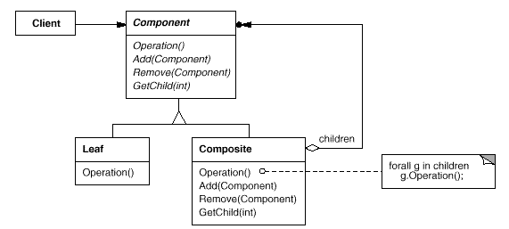
Structure

Slide 114
Participants
Component (Category)
declares the interface for objects in the composition.
implements default behavior for the interface common to all classes, as appropriate.
declares an interface for accessing and managing its child components.
(optional) defines an interface for accessing a component's parent in the recursive structure, and implements it if that's appropriate.
Leaf (Product)
represents leaf objects in the composition. A leaf has no children.
defines behavior for primitive objects in the composition.
Composite (Package)
defines behavior for components having children.
stores child components.
implements child-related operations in the Component interface.
Client
manipulates objects in the composition through the Component interface

Slide 115
Collaborations
Clients use the Component class interface to interact with objects in the composite structure.
If the recipient is a Leaf, then the request is handled directly.
If the recipient is a Composite, then it usually forwards requests to its child components, possibly performing additional operations before and/or after forwarding.

Slide 116
Consequences
Primitive objects can be composed into more complex objects
Makes the client simple
Clients can treat composite structures and individual objects uniformly
Clients normally don't know (and shouldn't care) whether they're dealing with a leaf or a composite component

Slide 117
Implementation
Explicit parent references
Maintaining references from child components to their parent can simplify the traversal and management of a composite structure
Sharing components.
It's often useful to share components, for example, to reduce storage requirements
A Sub-Category can be same for many other categories

Slide 118
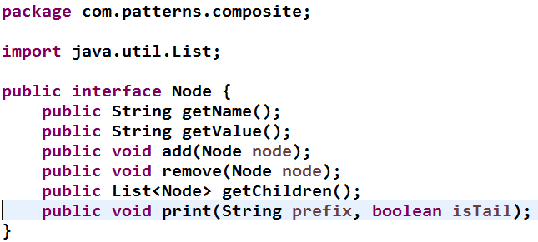
Sample Code

Slide 119
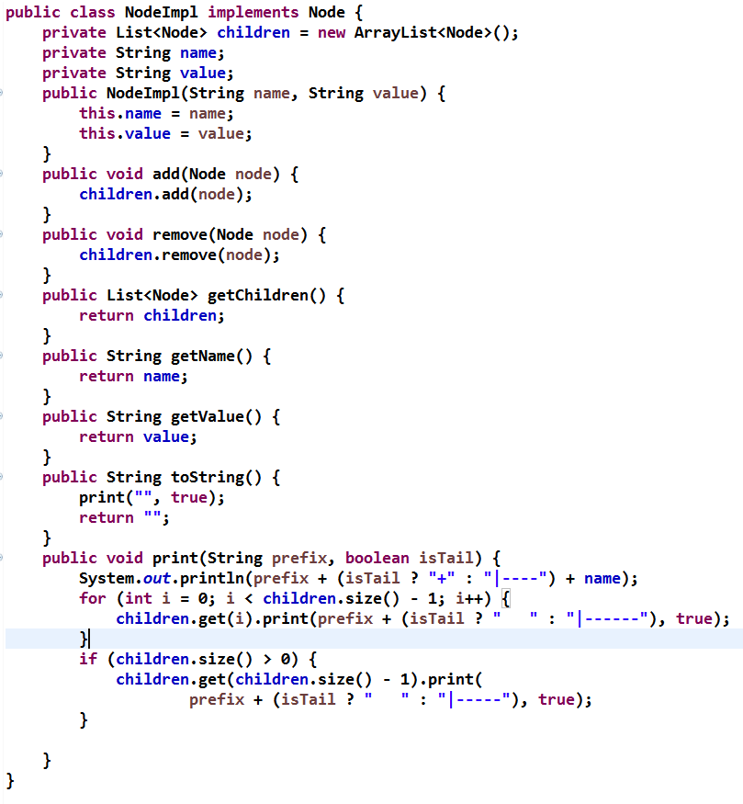
Sample Code

Slide 120
Known Uses
Component /Container
Collections Api
TreeModel

Slide 121
Related Patterns
Iterator
can be used to traverse composites.
Flyweight
lets you share components

Slide 122
Where are we
Adapter
Composite
FlyWeight
Proxy
Decorator
Façade
Bridge

Slide 123
FlyWeight
Structural Pattern

Slide 124
Intent
Use sharing to support large numbers of fine-grained objects efficiently.

Slide 125
Also Known As (A.K.A)
LightWeightFactory

Slide 126
Motivation
Some applications could benefit from using objects throughout their design, but a naive implementation would be prohibitively expensive.
Document wishes to display some image/bullets repeatedly
A flyweight is a shared object that can be used in multiple contexts simultaneously

Slide 127
Applicability
Apply the Flyweight pattern when all of the following are true:
An application uses a large number of objects.
Storage costs are high because of the sheer quantity of objects.
Most object state can be made extrinsic.
Many groups of objects may be replaced by relatively few shared objects once extrinsic state is removed.
The application doesn't depend on object identity. Since flyweight objects may be shared, identity tests will return true for conceptually distinct objects

Slide 128
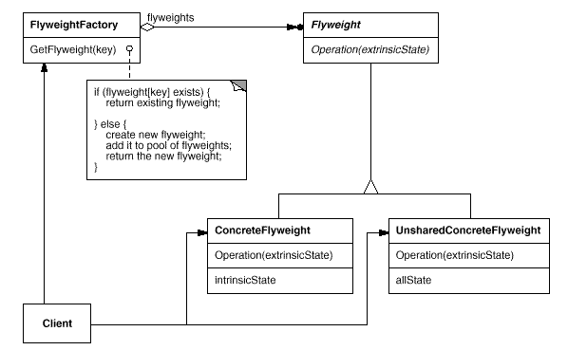
Structure

Slide 129
Participants
Flyweight
declares an interface through which flyweights can receive and act on extrinsic state.
ConcreteFlyweight (Character)
implements the Flyweight interface and adds storage for intrinsic state, if any. A ConcreteFlyweight object must be sharable. Any state it stores must be intrinsic; that is, it must be independent of the ConcreteFlyweight object's context.
UnsharedConcreteFlyweight (Row, Column)
not all Flyweight subclasses need to be shared. The Flyweight interface enables sharing; it doesn't enforce it. It's common for UnsharedConcreteFlyweight objects to have ConcreteFlyweight objects as children at some level in the flyweight object structure (as the Row and Column classes have).
FlyweightFactory
creates and manages flyweight objects.
ensures that flyweights are shared properly. When a client requests a flyweight, the FlyweightFactory object supplies an existing instance or creates one, if none exists.
Client
maintains a reference to flyweight(s).
computes or stores the extrinsic state of flyweight(s).

Slide 130
Collaborations
State that a flyweight needs to function must be characterized as either intrinsic or extrinsic.
Intrinsic state is stored in the ConcreteFlyweight object;
extrinsic state is stored or computed by Client objects. Clients pass this state to the flyweight when they invoke its operations.
Clients should not instantiate ConcreteFlyweights directly.
Clients must obtain ConcreteFlyweight objects exclusively from the FlyweightFactory object to ensure they are shared properly.

Slide 131
Consequences
Storage savings are a function of several factors:
the reduction in the total number of instances that comes from sharing
the amount of intrinsic state per object
whether extrinsic state is computed or stored

Slide 132
Implementation
Managing shared objects.
Understanding equals and hashCode

Slide 133
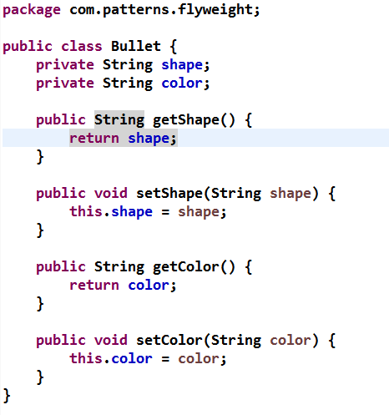
Sample Code

Slide 134
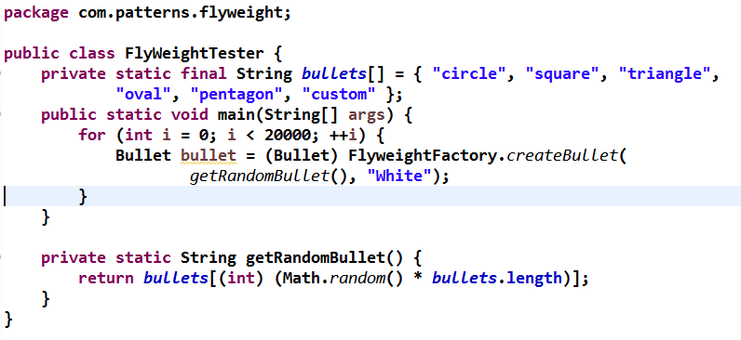
Sample Code

Slide 135
Known Uses
Document Editor
Imager View
Master Data Cache

Slide 136
Related Patterns
It's often best to implement State and Strategy objects as flyweights.

Slide 137
Where are we
Adapter
Composite
FlyWeight
Proxy
Decorator
Bridge
Facade

Slide 138
Proxy
Structural Pattern

Slide 139
Intent
Provide a surrogate or placeholder for another object to control access to it.

Slide 140
Also Known As (A.K.A)
Surrogate

Slide 141
Motivation
One reason for controlling access to an object is to defer the full cost of its creation and initialization until we actually need to use it.
Consider a document editor that can embed graphical objects in a document.
Some graphical objects, like large raster images, can be expensive to create.
But opening a document should be fast, so we should avoid creating all the expensive objects at once when the document is opened. This isn't necessary anyway, because not all of these objects will be visible in the document at the same time

Slide 142
Applicability
A remote proxy provides a local representative for an object in a different address space.
protection proxy controls access to the original object
smart reference is a replacement for a bare pointer that performs additional actions when an object is accessed

Slide 143
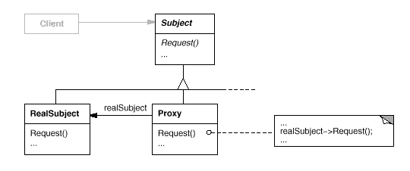
Structure

Slide 144
Participants
Proxy (ImageProxy)
maintains a reference that lets the proxy access the real subject. Proxy may refer to a Subject if the RealSubject and Subject interfaces are the same.
provides an interface identical to Subject's so that a proxy can by substituted for the real subject.
controls access to the real subject and may be responsible for creating and deleting it.
other responsibilities depend on the kind of proxy:
remote proxies are responsible for encoding a request and its arguments and for sending the encoded request to the real subject in a different address space.
virtual proxies may cache additional information about the real subject so that they can postpone accessing it. For example, the ImageProxy from the Motivation caches the real image's extent.
protection proxies check that the caller has the access permissions required to perform a request.
Subject (Graphic)
defines the common interface for RealSubject and Proxy so that a Proxy can be used anywhere a RealSubject is expected.
RealSubject (Image)
defines the real object that the proxy represents.

Slide 145
Collaborations
Proxy forwards requests to RealSubject when appropriate, depending on the kind of proxy.

Slide 146
Consequences
A remote proxy can hide the fact that an object resides in a different address space.
A virtual proxy can perform optimizations such as creating an object on demand.
Both protection proxies and smart references allow additional housekeeping tasks when an object is accessed.

Slide 147
Implementation
Static Proxy
Dynamic Proxy
Dynamic Proxy Without Interfaces

Slide 148
Sample Code
Ref Samples

Slide 149
Known Uses
RMIProxy
SpringProxy

Slide 150
Related Patterns
Adapter
adapter provides a different interface to the object it adapts. In contrast, a proxy provides the same interface as its subject.
Decorator
Although decorators can have similar implementations as proxies, decorators have a different purpose

Slide 151
Decorator
Structural Pattern

Slide 152
Intent
Attach additional responsibilities to an object dynamically. Decorators provide a flexible alternative to subclassing for extending functionality.

Slide 153
Also Known As (A.K.A)
Wrapper

Slide 154
Motivation
Sometimes we want to add responsibilities to individual objects, not to an entire class
One way to add responsibilities is with inheritance. Inheriting a border from another class puts a border around every subclass instance
A more flexible approach is to enclose the component in another object that adds the border

Slide 155
Applicability
to add responsibilities to individual objects dynamically and transparently, that is, without affecting other objects.
for responsibilities that can be withdrawn.
when extension by subclassing is impractical.

Slide 156
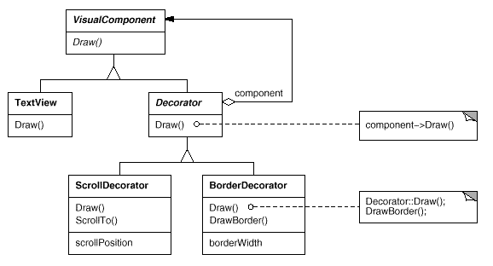
Structure

Slide 157
Participants
Component (VisualComponent)
defines the interface for objects that can have responsibilities added to them dynamically.
ConcreteComponent (TextView)
defines an object to which additional responsibilities can be attached.
Decorator
maintains a reference to a Component object and defines an interface that conforms to Component's interface.
ConcreteDecorator (BorderDecorator, ScrollDecorator)
adds responsibilities to the component

Slide 158
Collaborations
Decorator forwards requests to its Component object. It may optionally perform additional operations before and after forwarding the request.

Slide 159
Consequences
More flexibility than static inheritance
Avoids feature-laden classes high up in the hierarchy
decorator and its component aren't identical

Slide 160
Implementation
A decorator object's interface must conform to the interface of the component it decorates
There's no need to define an abstract Decorator class when you only need to add one responsibility
Keeping Component classes lightweight

Slide 161
Sample Code
Ref

Slide 162
Known Uses
Many object-oriented user interface toolkits use decorators to add graphical embellishments to widgets.

Slide 163
Related Patterns
decorator is different from an adapter in that a decorator only changes an object's responsibilities, not its interface

Slide 164
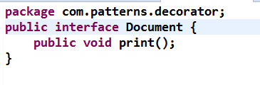
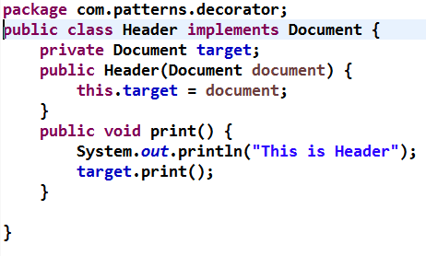
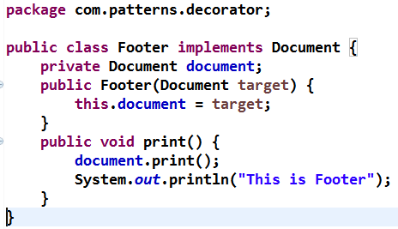
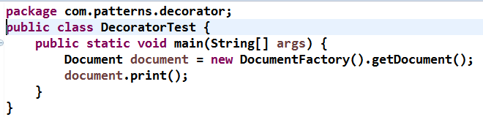
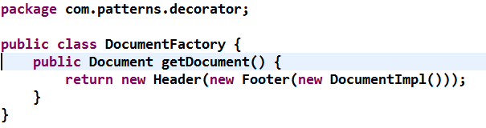
Sample Code

Slide 165
Where are we
Adapter
Composite
FlyWeight
Proxy
Decorator
Bridge
Facade

Slide 166
Bridge
Structural Pattern

Slide 167
Intent
Decouple an abstraction from its implementation so that the two can vary independently.

Slide 168
Also Known As (A.K.A)
Handle/Body

Slide 169
Motivation
When an abstraction can have one of several possible implementations

Slide 170
Applicability
you want to avoid a permanent binding between an abstraction and its implementation. This might be the case, for example, when the implementation must be selected or switched at run-time.

Slide 171
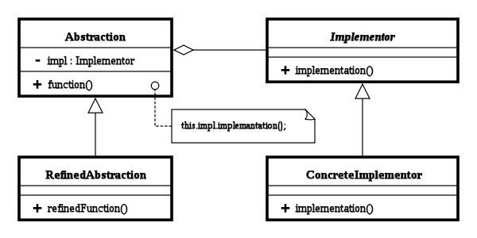
Structure

Slide 172
Participants
Abstraction defines the abstract interface maintains the Implementor reference
Refined Abstraction extends the interface defined by Abstraction
Implementor defines the interface for implementation classes
ConcreteImplementor implements the Implementor interface

Slide 173
Collaborations
Abstraction forwards client requests to its Implementor object.

Slide 174
Consequences
Decoupling interface and implementation. An implementation is not bound permanently to an interface.
Improved extensibility. You can extend the Abstraction and Implementor hierarchies independently.
Hiding implementation details from clients

Slide 175
Implementation
Only one Implementor.
In situations where there's only one implementation, creating an abstract Implementor class isn't necessary
Creating the right Implementor object.
How, when, and where do you decide which Implementor class to instantiate when there's more than one?

Slide 176
Sample Code
Ref Sample Code

Slide 177
Known Uses
Commons Logging

Slide 178
Related Patterns
AbstractFactory
Can Create and configure a particular bridge
Adapter
Is geared toward making unrelated classes work together

Slide 179
Where are we
Adapter
Composite
FlyWeight
Proxy
Decorator
Bridge
Facade

Slide 180
Façade
Structural Pattern

Slide 181
Intent
Provide a unified interface to a set of interfaces in a subsystem. Facade defines a higher-level interface that makes the subsystem easier to use.

Slide 182
Motivation
Structuring a system into subsystems helps reduce complexity. A common design goal is to minimize the communication and dependencies between subsystems. One way to achieve this goal is to introduce a facade object that provides a single, simplified interface to the more general facilities of a subsystem.

Slide 183
Applicability
you want to provide a simple interface to a complex subsystem.
there are many dependencies between clients and the implementation classes of an abstraction

Slide 184
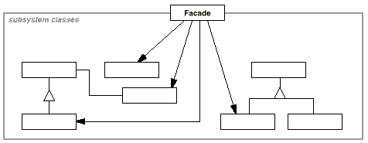
Structure

Slide 185
Participants
Facade (Compiler)
knows which subsystem classes are responsible for a request.
delegates client requests to appropriate subsystem objects.
subsystem classes (Scanner, Parser, ProgramNode, etc.)
implement subsystem functionality.
handle work assigned by the Facade object.
have no knowledge of the facade; that is, they keep no references to it.

Slide 186
Collaborations
Clients communicate with the subsystem by sending requests to Facade, which forwards them to the appropriate subsystem object(s).
Although the subsystem objects perform the actual work, the facade may have to do work of its own to translate its interface to subsystem interfaces.
Clients that use the facade don't have to access its subsystem objects directly.

Slide 187
Consequences
It shields clients from subsystem components,
It promotes weak coupling between the subsystem and its clients
Reducing compilation dependencies is vital in large software systems

Slide 188
Implementation
Reducing client-subsystem coupling.
The coupling between clients and the subsystem can be reduced even further by making Facade an abstract class with concrete subclasses

Slide 189
Sample Code
Ref

Slide 190
Known Uses
DriverManager

Slide 191
Related Patterns
AbstractFactory
Mediator

Slide 192
Summary of Structural Patterns
Adapter 6
Allows classes with incompatible interfaces to work together by wrapping its own interface around that of an already existing class.
Bridge 7
Decouples an abstraction from its implementation so that the two can vary independently.
Composite 8
Composes one-or-more similar objects so that they can be manipulated as one object.
Decorator 9
Dynamically adds/overrides behaviour in an existing method of an object.
Facade 10
Provides a simplified interface to a large body of code.

Slide 193
Summary of Structural Patterns
Flyweight 11
Reduces the cost of creating and manipulating a large number of similar objects.
Proxy 12
Provides a placeholder for another object to control access, reduce cost, and reduce complexity.

Slide 194
Behavioral Patterns

Slide 195
Behavioral Pattern
Behavioral Patterns
Chain Of Responsibility
Command
Observer
Iterator
Memento
State
Mediator
Strategy
Template Method
Visitor
Interpreter

Slide 196
Where are we
Command
Chain Of Responsibility
Iterator
Observer
Memento
State
Strategy
Template Method
Visitor
Interpreter
Mediator

Slide 197
Command
Behavioral Pattern

Slide 198
Intent
Encapsulate a request as an object, thereby letting you parameterize clients with different requests

Slide 199
Also Known As (A.K.A)
Action, Transaction

Slide 200
Motivation
A command object is a convenient temporary storage for procedure parameters
A class is a convenient place to collect code and data related to a command.

Slide 201
Applicability
parameterize objects by an action to perform

Slide 202
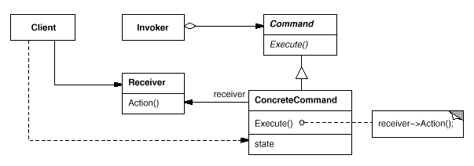
Structure

Slide 203
Participants
Command
declares an interface for executing an operation.
ConcreteCommand (PasteCommand, OpenCommand)
defines a binding between a Receiver object and an action.
implements Execute by invoking the corresponding operation(s) on Receiver.
Client (Application)
creates a ConcreteCommand object and sets its receiver.
Invoker (MenuItem)
asks the command to carry out the request.
Receiver (Editor)
knows how to perform the operations associated with carrying out a request. Any class may serve as a Receiver.

Slide 204
Collaborations
The client creates a ConcreteCommand object and specifies its receiver.
An Invoker object stores the ConcreteCommand object.
The invoker issues a request by calling Execute on the command. When commands are undoable, ConcreteCommand stores state for undoing the command prior to invoking Execute.
The ConcreteCommand object invokes operations on its receiver to carry out the request.

Slide 205
Consequences
Command decouples the object that invokes the operation from the one that knows how to perform it.
Commands are first-class objects. They can be manipulated and extended like any other object.
You can assemble commands into a composite command.
An example is the MacroCommand class described earlier. In general, composite commands are an instance of the pattern.
It's easy to add new Commands, because you don't have to change existing classes.

Slide 206
Implementation
How intelligent should a command be?
A command can have a wide range of abilities.
At one extreme it merely defines a binding between a receiver and the actions that carry out the request

Slide 207
Sample Code
Ref Samples

Slide 208
Known Uses
Action classes In Struts
ActionListener

Slide 209
Related Patterns
Composite (to Store CommandStack)

Slide 210
Where are we
Command
Chain Of Responsibility
Iterator
Observer
Memento
State
Strategy
Template Method
Visitor
Interpreter
Mediator

Slide 211
Chain Of Responsibility
Behavioral Pattern

Slide 212
Intent
Avoid coupling the sender of a request to its receiver by giving more than one object a chance to handle the request
Chain the receiving objects and pass the request along the chain until an object handles it.

Slide 213
Motivation
One request should be handled by more than one object.
Don't know which object should handle a request, probably more than one object will handle it automatically.
Reduce coupling.

Slide 214
Applicability
More than one object may handle a request, and the handler isn't known a priori. The handler should be ascertained automatically.
You want to issue a request to one of several objects without specifying the receiver explicitly.
The set of objects that can handle a request should be specified dynamically.

Slide 215
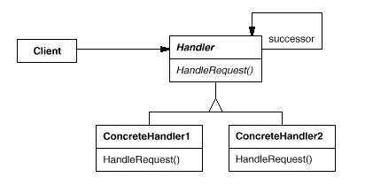
Structure

Slide 216
Participants
Handler (PurchasePower)
defines an interface for handling requests.
(optional) implements the successor link.
ConcreteHandler (Director,)
handles requests it is responsible for.
can access its successor.
if the ConcreteHandler can handle the request, it does so; otherwise it forwards the request to its successor.
Client
initiates the request to a ConcreteHandler object on the chain

Slide 217
Collaborations
When a client issues a request, the request propagates along the chain until a ConcreteHandler object takes responsibility for handling it.

Slide 218
Consequences
Reduced coupling
Receipt isn't guaranteed

Slide 219
Implementation

Slide 220
Sample Code

Slide 221
Known Issues
Filter Pattern

Slide 222
Related Patterns
Composite
The components Parent can act as its Successor

Slide 223
Where are we
Command
Chain Of Responsibility
Iterator
Observer
Memento
State
Strategy
Template Method
Mediator
Visitor
Interpreter

Slide 224
Iterator
Behavioral Pattern

Slide 225
Intent
Provide a way to access the elements of an aggregate object sequentially without exposing its underlying representation.

Slide 226
Also Known As (A.K.A)
Cursor

Slide 227
Motivation
An aggregate object such as a list should give you a way to access its elements without exposing its internal structure
The Iterator pattern lets you do all this.

Slide 228
Applicability
to access an aggregate object's contents without exposing its internal representation.
to support multiple traversals of aggregate objects.
to provide a uniform interface for traversing different aggregate structures (that is, to support polymorphic iteration).

Slide 229
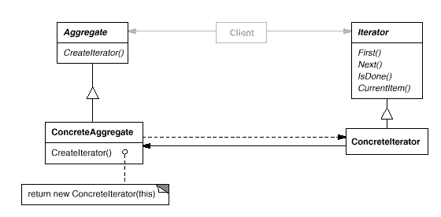
Structure

Slide 230
Participants
Iterator
defines an interface for accessing and traversing elements.
ConcreteIterator
implements the Iterator interface.
keeps track of the current position in the traversal of the aggregate.
Aggregate
defines an interface for creating an Iterator object.
ConcreteAggregate
implements the Iterator creation interface to return an instance of the proper ConcreteIterator

Slide 231
Collaborations
A ConcreteIterator keeps track of the current object in the aggregate and can compute the succeeding object in the traversal.

Slide 232
Consequences
Iterators simplify the Aggregate interface

Slide 233
Implementation
Who controls the iteration? A fundamental issue is deciding which party controls the iteration, the iterator or the client that uses the iterator.
How robust is the iterator?
It can be dangerous to modify an aggregate while you're traversing it. If elements are added or deleted from the aggregate

Slide 234
Sample Code

Slide 235
Known Uses
Iterators are common in object-oriented systems. Most collection class libraries offer iterators in one form or another.
The Collection Framework java

Slide 236
Related Patterns
Factory Method
Composite

Slide 237
Where are we
Command
Chain Of Responsibility
Iterator
Observer
Memento
State
Strategy
Template Method
Visitor
Interpreter
Mediator

Slide 238
Observer
Behavioral Pattern

Slide 239
Intent
Define a one-to-many dependency between objects so that when one object changes state, all its dependents are notified and updated automatically.

Slide 240
Also Known As (A.K.A)
Dependents, Publish-Subscribe

Slide 241
Motivation
A common side-effect of partitioning a system into a collection of cooperating classes is the need to maintain consistency between related objects.
You don't want to achieve consistency by making the classes tightly coupled, because that reduces their reusability

Slide 242
Applicability
Use the Observer pattern in any of the following situations:
When an abstraction has two aspects,
one dependent on the other.
Encapsulating these aspects in separate objects lets you vary and reuse them independently.
When a change to one object requires changing others, and you don't know how many objects need to be changed.
When an object should be able to notify other objects without making assumptions about who these objects are.
In other words, you don't want these objects tightly coupled.

Slide 243
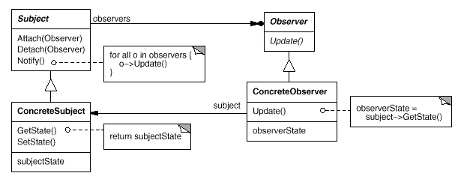
Structure

Slide 244
Participants
Subject (Observable)
knows its observers. Any number of Observer objects may observe a subject.
provides an interface for attaching and detaching Observer objects.
Observer (Monitoring System)
defines an updating interface for objects that should be notified of changes in a subject.
ConcreteSubject
stores state of interest to ConcreteObserver objects.
sends a notification to its observers when its state changes.
ConcreteObserver
maintains a reference to a ConcreteSubject object.
stores state that should stay consistent with the subject's.
implements the Observer updating interface to keep its state consistent with the subject's.

Slide 245
Collaborations
ConcreteSubject notifies its observers whenever a change occurs that could make its observers' state inconsistent with its own.
After being informed of a change in the concrete subject, a ConcreteObserver object may query the subject for information. ConcreteObserver uses this information to reconcile its state with that of the subject.

Slide 246
Consequences
Abstract coupling between Subject and Observer
Support for broadcast communication
Unexpected updates

Slide 247
Implementation
Mapping subjects to their observers. The simplest way for a subject to keep track of the observers it should notify is to store references to them explicitly in the subject
Observing more than one subject
It might make sense in some situations for an observer to depend on more than one subject

Slide 248
Sample Code

Slide 249
Known Uses
Publish/Subcribe
BeanPropertyChangeListener

Slide 250
Related Patterns
Singleton

Slide 251
Where are we
Command
Chain Of Responsibility
Iterator
Observer
Memento
State
Strategy
Template Method
Visitor
Interpreter
Mediator

Slide 252
Memento
Behavioral Pattern

Slide 253
Intent
Without violating encapsulation, capture and externalize an object's internal state so that the object can be restored to this state later.

Slide 254
Also Known As (A.K.A)
Token

Slide 255
Motivation

Slide 256
Applicability
Use the Memento pattern when
a snapshot of (some portion of) an object's state must be saved so that it can be restored to that state later, and
a direct interface to obtaining the state would expose implementation details and break the object's encapsulation.

Slide 257
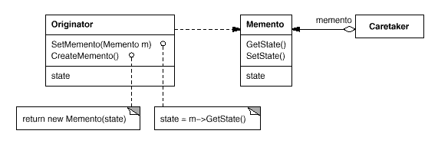
Structure

Slide 258
Participants
Memento (SolverState)
stores internal state of the Originator object. The memento may store as much or as little of the originator's internal state as necessary at its originator's discretion.
protects against access by objects other than the originator. Mementos have effectively two interfaces. Caretaker sees a narrow interface to the Memento—it can only pass the memento to other objects. Originator, in contrast, sees a wide interface, one that lets it access all the data necessary to restore itself to its previous state. Ideally, only the originator that produced the memento would be permitted to access the memento's internal state.
Originator (ConstraintSolver)
creates a memento containing a snapshot of its current internal state.
uses the memento to restore its internal state.
Caretaker (undo mechanism)
is responsible for the memento's safekeeping.
never operates on or examines the contents of a memento.

Slide 259
Collaborations
A caretaker requests a memento from an originator, holds it for a time, and passes it back to the originator,

Slide 260
Consequences

Slide 261
Implementation

Slide 262
Sample Code

Slide 263
Known Issues

Slide 264
Related Patterns

Slide 265
Where are we
Command
Chain Of Responsibility
Iterator
Observer
Memento
State
Strategy
Template Method
Visitor
Interpreter
Mediator

Slide 266
State
Behavioral Pattern

Slide 267
Intent
Allow an object to alter its behavior when its internal state changes. The object will appear to change its class.

Slide 268
Also Known As (A.K.A)
Objects for States

Slide 269
Motivation
Consider a class TCPConnection that represents a network connection.
A TCPConnection object can be in one of several different states: Established, Listening, Closed.
When a TCPConnection object receives requests from other objects

Slide 270
Applicability
Use the State pattern in either of the following cases:
An object's behavior depends on its state, and it must change its behavior at run-time depending on that state.
Operations have large, multipart conditional statements that depend on the object's state.

Slide 271
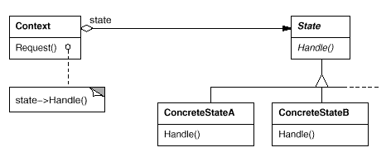
Structure

Slide 272
Participants
Context (TCPConnection)
defines the interface of interest to clients.
maintains an instance of a ConcreteState subclass that defines the current state.
State (TCPState)
defines an interface for encapsulating the behavior associated with a particular state of the Context.
ConcreteState subclasses (TCPEstablished, TCPListen, TCPClosed)
each subclass implements a behavior associated with a state of the Context.

Slide 273
Collaborations
Context delegates state-specific requests to the current ConcreteState object.
A context may pass itself as an argument to the State object handling the request. This lets the State object access the context if necessary.
Context is the primary interface for clients. Clients can configure a context with State objects. Once a context is configured, its clients don't have to deal with the State objects directly.
Either Context or the ConcreteState subclasses can decide which state succeeds another and under what circumstances.

Slide 274
Consequences
It localizes state-specific behavior and partitions behavior for different states

Slide 275
Implementation

Slide 276
Sample Code

Slide 277
Known Uses

Slide 278
Related Patterns
State Objects are normally Singleton
Flyweight when and how State objects can be shared

Slide 279
Where are we
Command
Chain Of Responsibility
Iterator
Observer
Memento
State
Strategy
Template Method
Visitor
Interpreter
Mediator

Slide 280
Strategy
Behavioral Pattern

Slide 281
Intent
Define a family of algorithms, encapsulate each one, and make them interchangeable. Strategy lets the algorithm vary independently from clients that use it.

Slide 282
Also Known As (A.K.A)
Policy

Slide 283
Motivation
Objects have responsibilities.
Different, specific implementations of these responsibilities are manifested through the use of polymorphism.
There is a need to manage several different implementations of what is, conceptually, the same algorithm.
It is a good design practice to separate behaviors that occur in the problem domain from each other— that is, to decouple them.
This allows to change the class responsible for one behavior without adversely affecting another

Slide 284
Applicability
Many related classes differ only in their behavior. Strategies provide a way to configure a class with one of many behaviors
you need different variants of an algorithm
an algorithm uses data that clients shouldn't know about

Slide 285
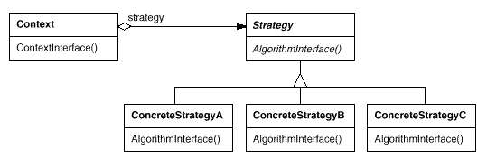
Structure

Slide 286
Participants
Strategy (TaxCalculation)
declares an interface common to all supported algorithms. Context uses this interface to call the algorithm defined by a ConcreteStrategy.
ConcreteStrategy (MaharashtraST,GujratST)
implements the algorithm using the Strategy interface.
Context (SalesOrder)
is configured with a ConcreteStrategy object.
maintains a reference to a Strategy object.
may define an interface that lets Strategy access its data

Slide 287
Collaborations
Strategy and Context interact to implement the chosen algorithm. A context may pass all data required by the algorithm to the strategy when the algorithm is called. Alternatively, the context can pass itself as an argument to Strategy operations. That lets the strategy call back on the context as required.
A context forwards requests from its clients to its strategy. Clients usually create and pass a ConcreteStrategy object to the context; thereafter, clients interact with the context exclusively. There is often a family of ConcreteStrategy classes for a client to choose from.

Slide 288
Consequences
Families of related algorithms. Hierarchies of Strategy classes define a family of algorithms or behaviors for contexts to reuse
An alternative to subclassing. Inheritance offers another way to support a variety of algorithms or behaviors. You can subclass a Context class directly to give it different behaviors. But this hard-wires the behavior into Context
Runtime choice of implementations

Slide 289
Implementation
Defining the Strategy and Context interfaces. The Strategy and Context interfaces must give a ConcreteStrategy efficient access to any data it needs from a context, and vice versa.

Slide 290
Sample Code

Slide 291
Known Uses
Runtime Selection Algorithm

Slide 292
Related Patterns

Slide 293
Where are we
Command
Chain Of Responsibility
Iterator
Observer
Memento
State
Strategy
Template Method
Visitor
Interpreter
Mediator

Slide 294
Template Method
Behavioral Pattern

Slide 295
Intent
Define the skeleton of an algorithm in an operation, deferring some steps to subclasses. Template Method lets subclasses redefine certain steps of an algorithm without changing the algorithm's structure.

Slide 296
Motivation
The Template Method is a pattern intended to help one abstract out a common process from different procedures.
According to the Gang of Four, the intent of the Template method is to Define the skeleton of an algorithm in an operation, deferring some steps to subclasses.
Redefine the steps in an algorithm without changing the algorithm's structure.

Slide 297
Applicability
The Template Method pattern should be used
to implement the invariant parts of an algorithm once and leave it up to subclasses to implement the behavior that can vary.
when common behavior among subclasses should be factored and localized in a common class to avoid code duplication

Slide 298
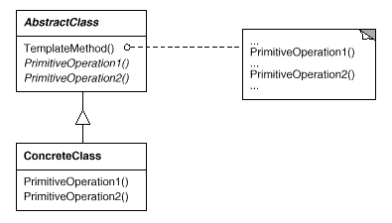
Structure

Slide 299
Participants
AbstractClass (IDAO)
defines abstract primitive operations that concrete subclasses define to implement steps of an algorithm.
implements a template method defining the skeleton of an algorithm. The template method calls primitive operations as well as operations defined in AbstractClass or those of other objects.
ConcreteClass (IDAOOracleImpl,IDAOSQLImpl)
implements the primitive operations to carry out subclass-specific steps of the algorithm.

Slide 300
Collaborations
ConcreteClass relies on AbstractClass to implement the invariant steps of the algorithm.

Slide 301
Consequences
concrete operations (either on the ConcreteClass or on client classes);
concrete AbstractClass operations (i.e., operations that are generally useful to subclasses);
primitive operations (i.e., abstract operations);

Slide 302
Implementation
Template methods are so fundamental that they can be found in almost every abstract class

Slide 303
Sample Code

Slide 304
Known Use
DAO

Slide 305
Related Patterns
Template methods use inheritance to vary part of an algorithm. Strategies use delegation to vary the entire algorithm.
Factory are often called by template methods. In the Motivation example, the factory method DoCreateDocument is called by the template method OpenDocument

Slide 306
Where are we
Command
Chain Of Responsibility
Iterator
Observer
Memento
State
Strategy
Template Method
Visitor
Interpreter
Mediator

Slide 307
Visitor
Behavioral Pattern

Slide 308
Intent
Represent an operation to be performed on the elements of an object structure.
Visitor lets you define a new operation without changing the classes of the elements on which it operates.

Slide 309
Motivation
Before we explore the Mediator pattern in any depth, first consider the example of an air traffic controller, and the various aircraft it helps to guide.
Imagine what would happen if there were no air traffic controllers. Each and every aircraft would have to know about every other aircraft in order to avoid collisions with them. This would certainly be a cause for disaster, as it would be far too difficult for each plane to keep track of all other aircraft in the vicinity.
So, to remedy this, we have the air traffic controller. Instead of having all aircraft communicating directly with one another, they simply send the controller their flight data and the controller then decides what other aircraft need to be informed. This is clearly far more efficient, and in this case, much safer, than the alternative. This is a perfect example of the Mediator pattern in the real-world

Slide 310
Applicability

Slide 311
Structure

Slide 312
Participants

Slide 313
Collaborations

Slide 314
Consequences

Slide 315
Implementation

Slide 316
Sample Code

Slide 317
Known Issues

Slide 318
Related Patterns

Slide 319
Where are we
Command
Chain Of Responsibility
Iterator
Observer
Memento
State
Strategy
Template Method
Visitor
Interpreter
Mediator

Slide 320
Interpreter
Behavioral Pattern

Slide 321
Intent

Slide 322
Also Known As (A.K.A)

Slide 323
Motivation

Slide 324
Applicability

Slide 325
Structure

Slide 326
Participants

Slide 327
Collaborations

Slide 328
Consequences

Slide 329
Implementation

Slide 330
Sample Code

Slide 331
Known Issues

Slide 332
Related Patterns

Slide 333
Where are we
Command
Chain Of Responsibility
Iterator
Observer
Memento
State
Strategy
Template Method
Visitor
Interpreter
Mediator

Slide 334
Mediator
Behavioral Pattern

Slide 335
Intent

Slide 336
Also Known As (A.K.A)

Slide 337
Motivation

Slide 338
Applicability

Slide 339
Structure

Slide 340
Participants

Slide 341
Collaborations

Slide 342
Consequences

Slide 343
Implementation

Slide 344
Sample Code

Slide 345
Known Issues

Slide 346
Related Patterns

Slide 347
Summary of Behavioral Patterns
Chain of responsibility 13
Delegates commands to a chain of processing objects.
Command 14
Creates objects which encapsulate actions and parameters.
Interpreter 15
Implements a specialized language.
Iterator 16
Accesses the elements of an object sequentially without exposing its underlying representation.
Mediator 17
Allows loose coupling between classes by being the only class that has detailed knowledge of their methods.
Memento 18
Provides the ability to restore an object to its previous state (undo).

Slide 348
Summary of Behavioral Patterns
Observer 19
A publish/subscribe pattern which allows a number of observer objects to see an event.
State 20
Allows an object to alter its behavior when its internal state changes.
Strategy 21
Allows one of a family of algorithms to be selected on-the-fly at runtime.
Template 22
Method defines the skeleton of an algorithm as an abstract class, allowing its subclasses to provide concrete behavior.
Visitor 23
Separates an algorithm from an object structure by moving the hierarchy of methods into one object.

